Slide 1
Lecture 10: Online Learning

Slide 2
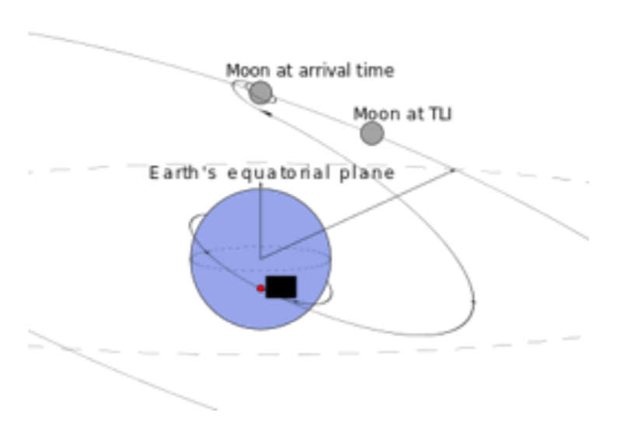
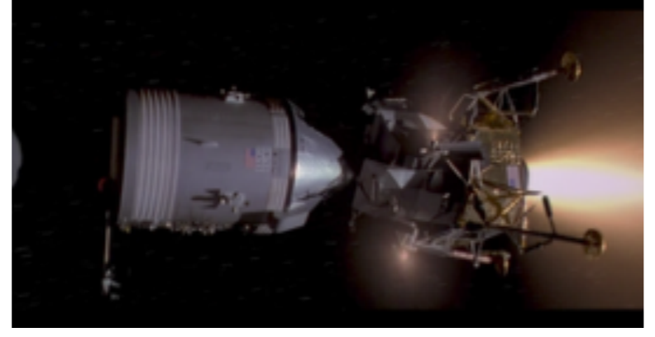
Online learning example: to the moon (the first time)
Guidance computer predicts trajectories to the moon and back with
  Noisy sensors
  Imperfect models
  Little computational power

Slide 3
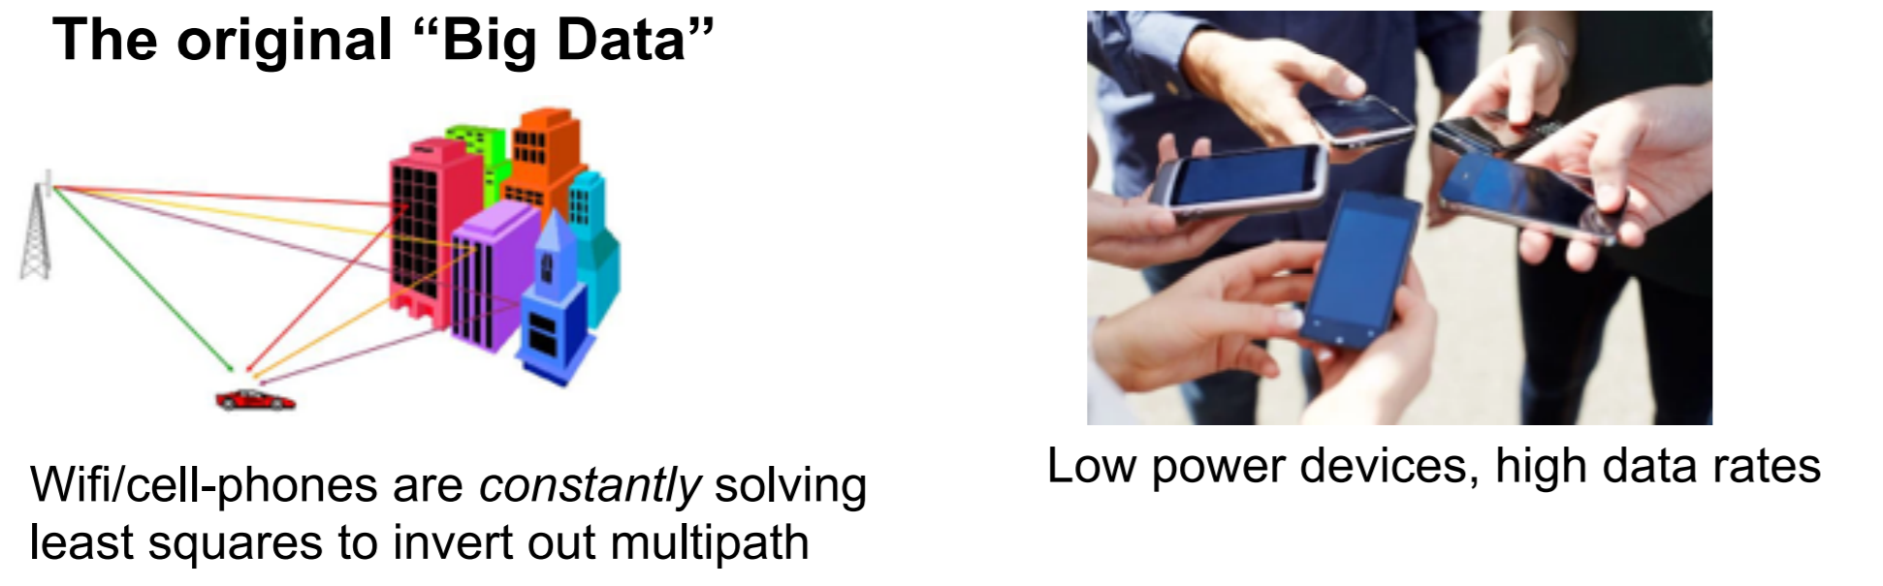
Online learning -- recently

Slide 4
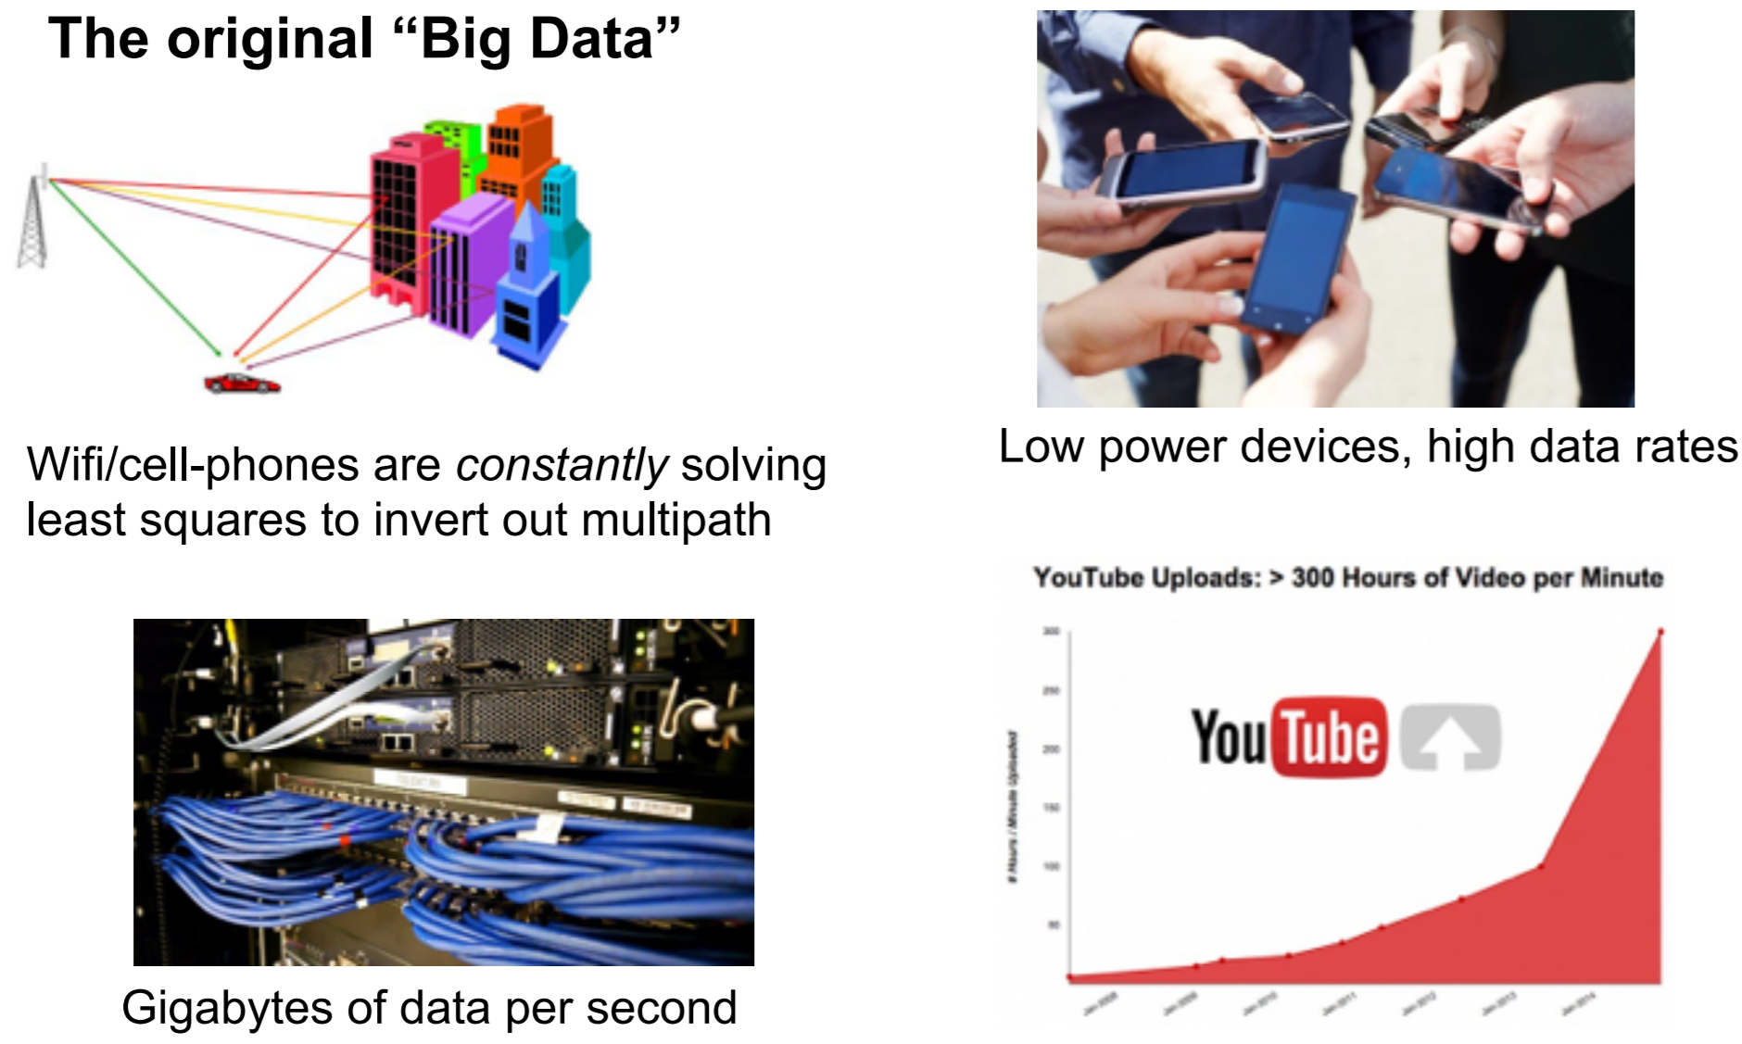
Online learning -- recently

Slide 5
Online learning
Predictive ads deal with streaming data
  User enters a query, and an ad must be selected
    Observe the query, X_{j}, predict the ad – clicked or not clicked, Y_{j}!
  User either clicks the ad or doesn’t click the ad
    Label on Y_{j} revealed afterwards
      Google (or Facebook or whoever) gets a reward if the ad is clicked
  Update the model for next time

Slide 6
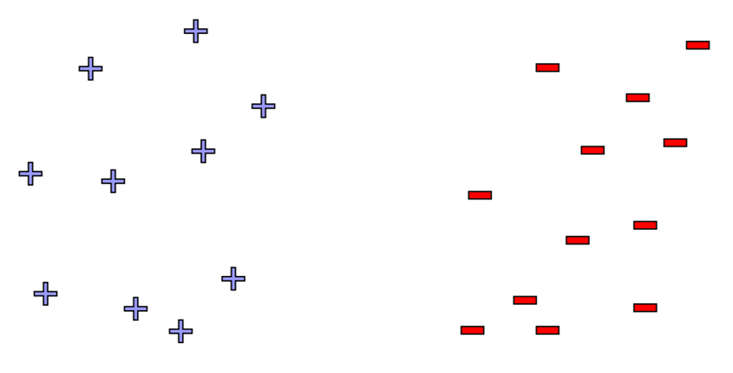
Online classification

Slide 7
The perceptron algorithm
Say y takes values {-1, 1}
Linear model – prediction y_{k} ~ sin(x_{k}w + b)
Training:
  Initialize weights (w₀, b₀)
  At each step, k:
    Observe features
    Make predictions
    Observe true class
    Update model if prediction is not equal to the truth

Slide 8
Perceptron algorithm
Perceptron is guaranteed to converge as long as the data is linearly separable

Slide 9
Perceptron algorithm
The algorithm has that limitation, but is otherwise really cool!
  No assumption about data distribution, does not need to be i.i.d.
  Could be generated by an oblivious adversary
  Makes a fixed number of mistakes, and it’s done forever
    Even as you see infinite data
But…perceptron is useless in practice
  Real world data are not linearly separable
  If it isn’t separable, algorithm cycles forever
  Even if separable, algorithm may not give good accuracy (may have small margin)

